Slide 1

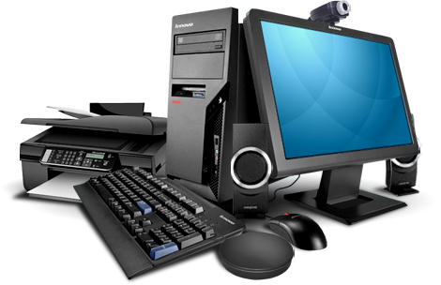


Computer
Software
Class V
lab 6

Slide 2
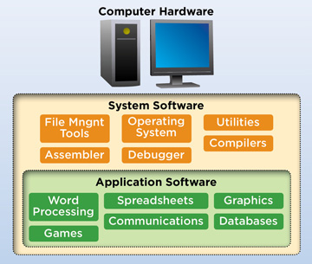
Computer Software

Slide 3
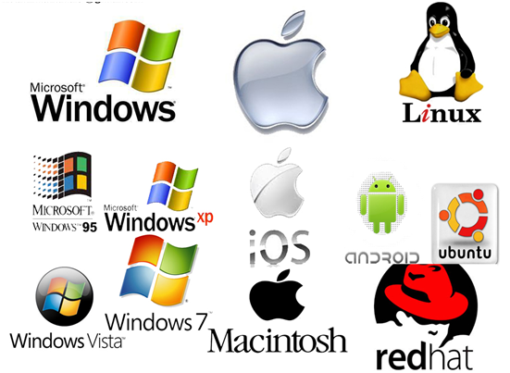
System Software
It is a base for application
software which is responsible
for managing hardware

Slide 4

Application Software
Application software is software designed to perform a group of coordinated functions, tasks, or activities for the benefit of the user

Slide 5

Skype
a telecommunications application that specializes in providing video chat and voice calls

Slide 6

Gmail
Gmail is a free email service developed by Google

Slide 7
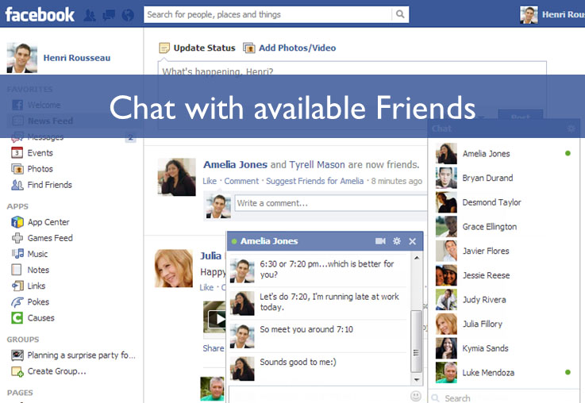
Facebook
social networking site that makes it easy for you to connect and share with family and friends online

Slide 8
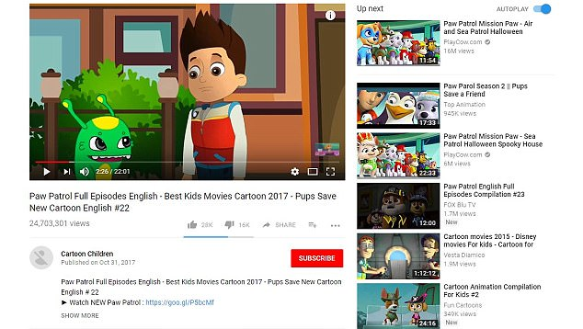
YouTube
YouTube is a video sharing service where users can watch, like, share, comment and upload their own videos

Slide 9


